Slide 1


Capstone Project Phase 1 Shelter Construction Information System
Project Supervisor:
Assoc. Prof. Zeev Barzily.
Presented by:
Almog Khaikin
Nir Betesh

Slide 2
The Problem
The shelter construction company has been relying on manual paperwork to manage all their work.
This is tedious, error-prone and limiting in many ways.
Lack of a good software solution leads to loss of revenue as the company can't take on as many contracts as it otherwise could.
The well-structured and rigid process behind the company's work makes it a great candidate for streamlining by the use of a software solution.

Slide 3
Existing solutions
There are many existing solutions that could help solve the company's problems:
ERP systems, spreadsheets.
These solutions are general-purpose, and as such, tend to be complex to learn and use, especially for employees that are not particularly tech-savvy.
Such general solutions often lack certain key features and contain many additional unnecessary features, leading to a more bloated product.
A purpose-built solution could help address many of the above issues.

Slide 4
The Solution
Paperless system management.
Specific solution, and not generic.
Inventory management.
Data management.
Notes:
Sepecific solotion, and not generic – system specific to the shelter construction company.
Inventory Management – current solotion dose not have inventory menegmant.
Data mengment – track history, date, team and such.

Slide 5
The Solution
Functional Requirements
1 | The system allows the CEO to add and remove employees, including secretaries and installers.
2 | The system enables employees to log in with unique credentials.
3 | The system enables secretaries to create, edit, and view construction contracts.
4 | The system stores details for each contract, including location, number of apartments, price, customer contact information, materials needed, and status.
5 | The system allows updating of contract statuses from pending to active upon customer acceptance.
6 | The system tracks and updates inventory levels of materials.
7 | The system generates automatic alerts when inventory levels are low, prompting the ordering of additional materials.

Slide 6
The Solution
Functional Requirements
8 | The system allows secretaries to build schedules for installers based on contract requirements.
9 | The system enables installers to access their schedules and mark tasks as completed.
10 | The system updates the progress status of each apartment within a contract based on installer updates and secretary inputs.
11 | The system generates progress reports based on updates from secretaries and installers.
12 | The system provides overviews of active and historical contracts accessible by the CEO and secretaries.

Slide 7
The Solution
Non-Functional Requirements
1 | Provides a user-friendly interface that is intuitive and easy to navigate for all user roles including CEOs, secretaries, installers, and inventory managers.
2 | Handles multiple user access simultaneously without degradation in performance, ensuring efficient data processing and responsive interactions.
3 | Implements secure login and authentication mechanisms to protect sensitive company and employee information.
4 | Enforces role-based access control, ensuring that employees can only access features and data relevant to their specific roles.

Slide 8
The Solution
Non-Functional Requirements
5 | Scales to support an increasing number of users, contracts, and data volume without loss of performance or functionality.
6 | Designed for high availability with minimal downtime to support continuous business operations.
7 | Includes robust error handling and data recovery mechanisms to ensure data integrity and consistent performance.
8 | Easily maintained, allowing for straightforward updates and enhancements.
9 | Supports modular design principles to facilitate future enhancements and integrations without disrupting existing functionality.

Slide 9
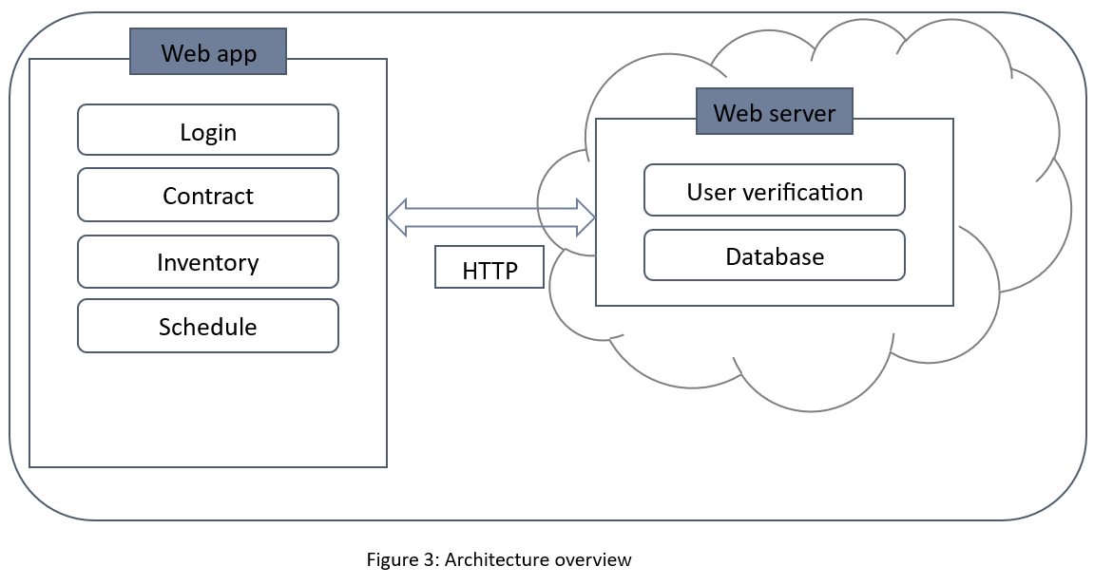
The Solution
Software Architecture Overview:

Slide 10
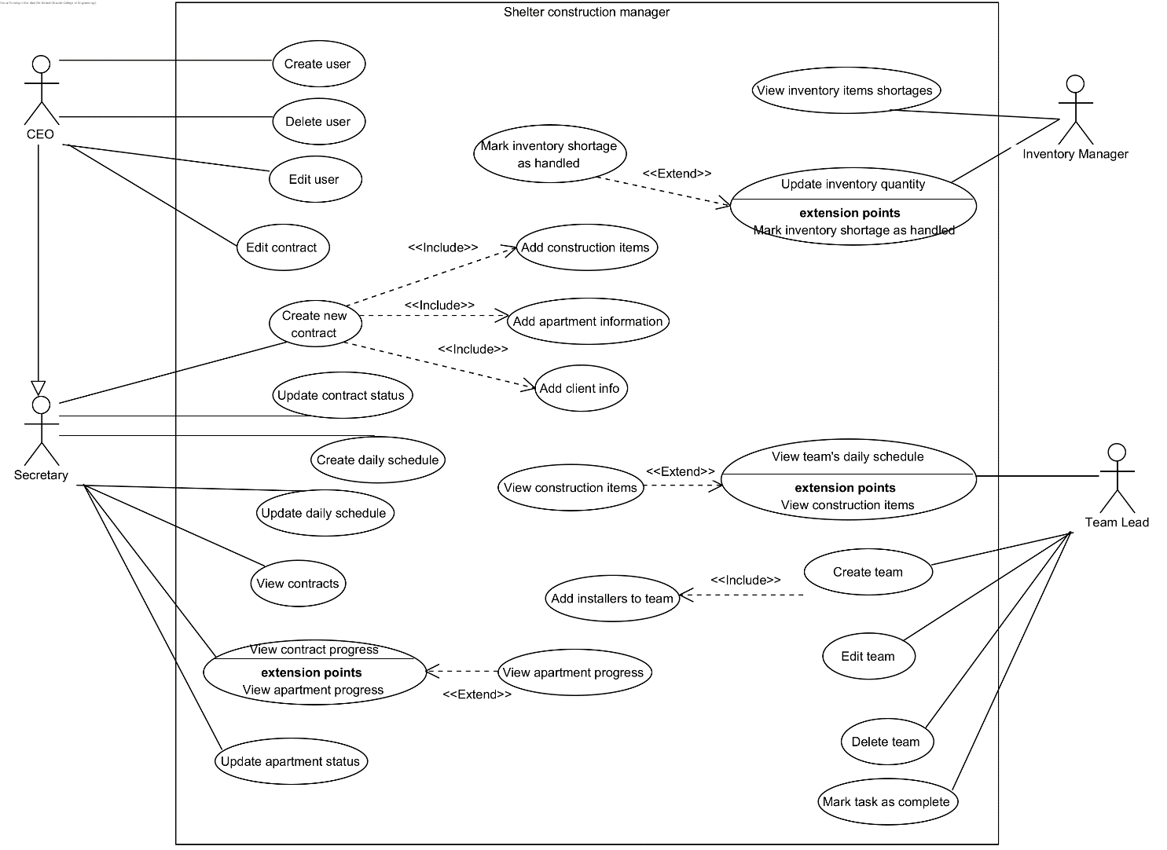
The Solution
Use Case Diagram:

Slide 11
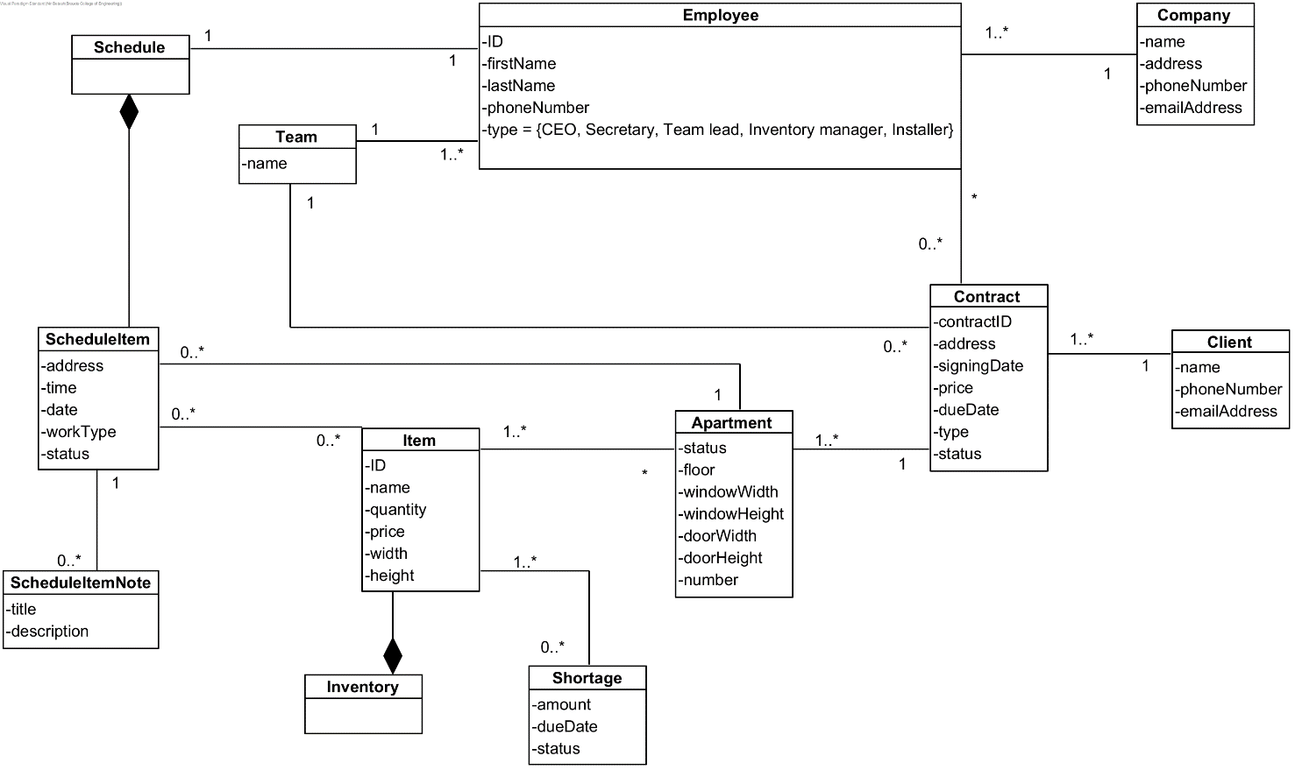
The Solution
Class Diagram:

Slide 12
Test Plan
Iterative Testing.
Test-Driven Development (TDD).
Unit Testing.
End-To-End Testing.
Performance and Stress Testing.
Regression testing.
Notes:
1. Iterative Testing
The development is broken down into manageable iterations or sprints, each resulting in a potentially shippable product increment. Testing is conducted at the end of each iteration to validate the work and refine or re-prioritize the backlog.
2. Test-Driven Development (TDD)
In TDD, test cases are developed before the actual software components. These tests define desired improvements or new functions and initially fail. As the development progresses, code is refined until the tests pass. This ensures that the software is built to meet precisely defined requirements from the outset.
3. Unit testing
We will use Jest for all unit tests.
Scope: Each module, component, and utility function will have corresponding unit tests to check individual functionalities in isolation.
4. End-to-End Testing
Tools: Although traditionally outside the scope of Jest, basic end-to-end testing can be simulated by testing sequences of actions that span multiple modules.
Scope: Ensure that the complete flow from the front end to the back end works as expected for critical processes.
Example: Simulating the complete process of a user signing a contract, from filling out forms to the submission and confirmation processes.
5. Performance and Stress Testing
Test the system under high load conditions to ensure it can handle multiple simultaneous operations across different modules. E.g. many teams tried to mark as complete when they have finished the construct.
6. Regression testing
Continuously re-test the system functionalities after every change in the codebase to ensure new changes do not break existing functionalities.

Slide 13
Test Plan
Unit Testing:
Component | Test Case | Expected Result
User Login | User attempts to log in with valid credentials. | User is successfully logged in and redirected to the appropriate dashboard.
Employee Management | CEO adds, removes, or modifies an employee. | System updates employee records and reflects changes immediately.
Contract Management | Secretary creates, updates, or completes a contract. | Contract status is updated in the system and visible to authorized roles.
Inventory Management | Inventory manager updates or checks inventory levels. | Inventory levels are accurately adjusted and displayed in real-time.

Slide 14
Test Plan
Manual Testing:
Test Case | Steps | Expected Results
Employee Role Management by CEO | CEO logs in, navigates to employee management, adds/removes/modifies employee. | CEO views, modifies employee data; system confirms changes.
Contract Management by Secretary | Secretary logs in, creates a contract, updates it to active, schedules installers, marks as completed. | Secretary can manage contracts fully with updates reflected in system.
Inventory Management | Inventory manager logs in, checks materials, updates inventory, deducts materials. | Inventory accurately tracked and adjusted with system updates.
Installer Task Management | Installer logs in, views tasks, marks task as completed. | Installer sees schedule, updates task status correctly; system tracks progress.
Contract Viewing and History | CEO/secretary logs in, navigates to contracts, views active/completed contracts, accesses full history. | Contracts are displayed with options to view historical data.

Slide 15
The Challenges
The system needs to support multiple users accessing the system and manipulating data simultaneously.
This means that the system must be able to synchronize access to the database while ensuring the clients are always in a consistent state.
The system needs to be accessible from many locations, both from company offices and from field workers that are reporting their progress.
A web-based client that communicates with a server hosted in the cloud helps ensure maximum availability from any location as long as there is an internet connection.

Slide 16
Constraints
Since most of the company's employees are tech-illiterate, the system has to be simple to use, easy to learn and hard to make mistakes with.
The maintenance of the system should be straightforward, such that even a non-programmer can login to their cloud host's service and make some minimal changes.

Slide 17

Thank you for listening! Any questions?

